Slide 1
A Crash Course in
HARDWARE
SIGMil

Slide 2
“Real world” hardware (analog)
“Virtual world” hardware (digital)

Slide 3
Analog Stuff
Voltage and Current
Discrete Components
Printed Circuit Boards
  Design
  Mounting Components
Building an Example Board
  Bill of Materials
  Considerations
  Tools
  Putting It Together

Slide 4
Voltage and Current
Voltage is also called potential
  Think of it as the possibility of moving electrons (how fast they’ll be moved once they’re allowed)
Current is the actual movement of electrons
  Measured as the number of electrons per second
As you could imagine, these are related..

Slide 5
Discrete Components
Resistors
Made of a piece of materials which slows down the current and builds up potential
  But electrons do not actually build up since charge is flowing

Slide 6
Discrete Components
Capacitors
Usually made of two parallel plates with a non-conducting material between then; current does not flow
  -Both potential and charge are built up

Slide 7
Discrete Components
Inductors
Made of a loop of conducting material which slows down charge due to electromagnetic field
  Can build up potential

Slide 8
Other Fancy Things
Simple sensors which enable you to do magical things
  Thermistor
  IR Diode/Phototransistor
  Accelerometer
  Microphone
These are all very easy to use, and later we will see about interfacing to them

Slide 9
PCB
Printed Circuit Board
  Silicon surface with wires (traces) and holes (vias) embedded
Straight forward to design PCB
  Essentially draw the theoretical circuit out and the rest is done almost automatically
    Place, route and design rule check

Slide 10
Mounting Things on PCBs
Everyone has probably seen soldering irons … but what about 200+ pins on a chip?
There are better ways to put these things on PCBs (especially tiny chips):
  Reflow soldering
  Oven soldering
We’ll be trying all of these this year

Slide 11
Building an Example Board
Our board will contain a FPGA which must be powered and fed a clock signal
  1.2V and 2.5V
  10 MHz clock crystal requires ~5V supply

Slide 12
Example Board BoM
What do we need?
  Mounting surface
    Schmartboards
  The FPGA
  A power source
    Batteries
  Voltage Regulators
  Crystal
  Associated capacitors, resistors and inductors

Slide 13
Example Board Considerations
Things we need to consider in general:
  How much current will be used?
    Thickness of wires
    Types of power source for battery
      Li-Ion vs NiCAD vs NiMH
    Current limiting
  High-frequency effects of wires
    Skin effect
    Length of wire
  Operating temperature
  Many more..

Slide 14
Example Board Tools
Soldering iron/hot air gun
Flux, Solder
Wire cutters/strippers
Multimeter (voltage/current measurements)
Pliers

Slide 15
Putting it together
READ DOCUMENTATION 3 TIMES OVER
  Otherwise you will probably burn something out
Draw out the intended circuit
Tape down components
Solder components
Add in wires
Check wires correspond to drawing
Solder wires in
Testing, debugging….
We’ll go through this process for real in a week or two.

Slide 16
Digital Stuff
History
Transistors
Logic Gates
Registers
Interfacing to Analog Stuff
FPGAs
  Logic Design Process
  Embedded System
  Programming FPGAs

Slide 17
History
“Standing on the shoulders of giants…”
Take a modern-day processor and all the knowledge of creating it back in time 50 years: how much is it worth?
We can get parts for cheap:
  $10 FPGA (equiv. of an entire 15 year old computer in a 20mm x 20mm chip)
  $1 Clock oscillator
  etc.

Slide 18
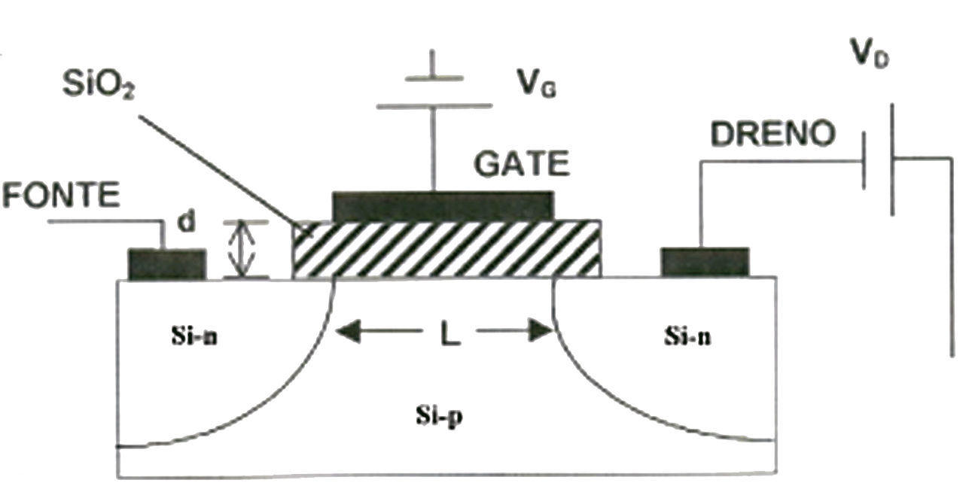
How a Transistor Works
In this context (digital), as a switch to low/high voltage
  (0V -> 1.2/2.5/3.3/5V)
  Not much current flow (<5 mA)

Slide 19
::Gibson draws on board to show basic logic, registers and MUXes::

Slide 20
FPGAs
Bunch of configurable logic
  Can implement arbitrary boolean functions
Can include other goodies:
  Multiplication, SDRAM, IP cores

Slide 21
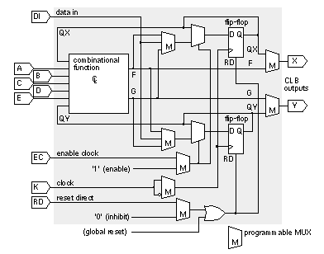
FPGAs: Basic Blocks
Typical FPGA may have 2,000-20,000 Configurable Logic Blocks (CLBs)

Slide 22
Logic Design Process
Write out end goals of logic
List the big steps to reach that goal
Define each big step as a black box
Define the interfaces between black boxes
Pick a box and go to step 1 until you are at a basic level where you are drawing the gates within the black box.
Once you’re finished with all boxes, write up the logic of each block in VHDL (hardware description language).
Much like programming, its all about abstraction and defining good interfaces.

Slide 23
Embedded Systems
Xilinx has tools to make SoC creation -very- easy:
  Embedded Developer Kit (EDK)
Includes 32-bit processor and peripherals
  Ethernet controller, Memory controller, general purpose I/O, ADC converter (!)
  Etc.

Slide 24
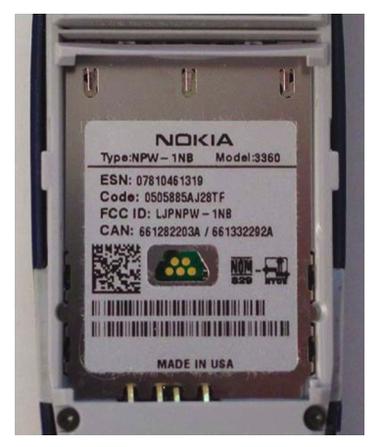
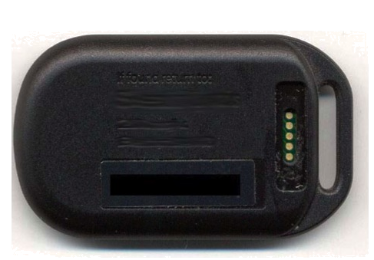
FPGAs: Programming
JTAG Interface
  Industry standard (pretty much /EVERY/ chip out there has this)
  Allows us to get to some internal state of a chip, interact with registers, etc.

Slide 25
FPGAs: Programming
Bitfile is streamed to the FPGA, it configures itself temporarily (until the power is reset)
  Internally, a bunch of RAM is written to and this configures the MUXs and LUT in the CLB

Slide 26
Projects
Build FPGA Board and then. …
  Bus snooping
  Ethernet snooping
  Logic analyzer
  Crazy, sensor-laden piece of HW
Rev-Eng Hardware
  JTAG interface probing SW
Quadrocopter

